Slide 1




INTRODUCTION
WEB APPLICATION PROGRAMMING
Final Project
Progress Presentation
PARK Sejoeng
202125203

Slide 2






INTRODUCTION
CONTENTS
1. Project Overview
2. Work Completed So Far
3. Upcoming Plans
Default Screen layout
Main Data source
Technologies Used
Current Web Page Description
Features Attempted So Far
Errors and Issues
Features to Add and Modify by the First Week of December

Slide 3



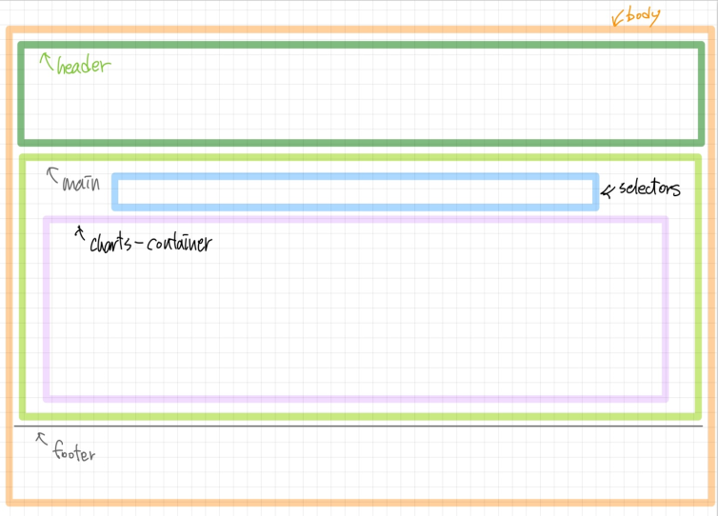
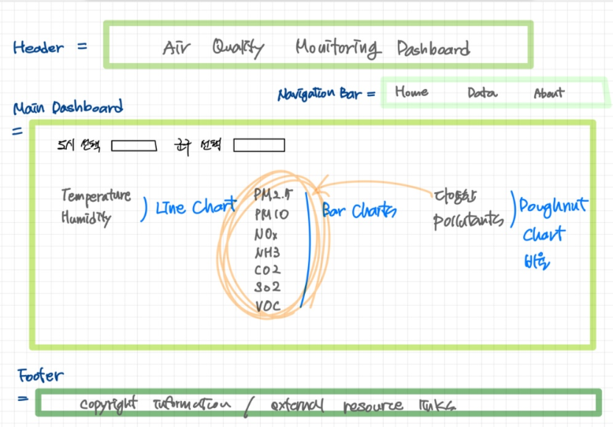
Project Overview
Default screen layout

Slide 4
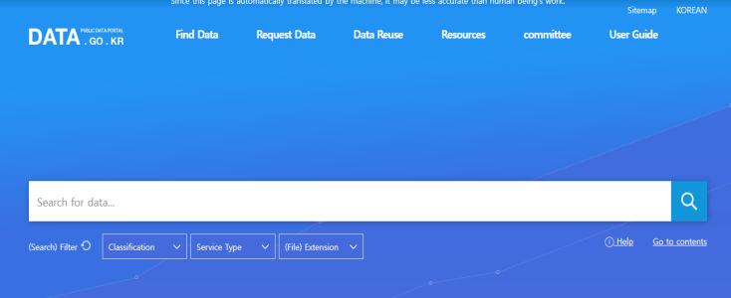
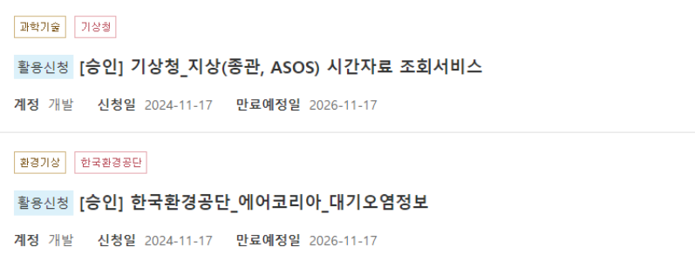
Project Overview
Main data sources
주요 데이터 출처
Introduction to key data
주요 데이터 소개
기상청 (Korea Meteorological Administration (KMA)) API: Temperature and Humidity
- Hourly average temperature (1-hour intervals)
- Hourly average humidity (1-hour intervals)
한국환경공단 (Korea Environment Corporation (KECO)) API: Air Quality Data
-PM2.5 (Unit: µg/m³)
-PM10 (Unit: µg/m³)
-NO2 (Unit: ppm)
-CO (Unit: ppm)
-SO2 (Unit: ppm)

Slide 5

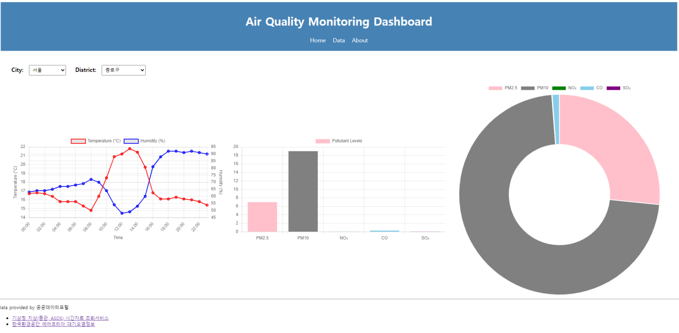
Work Completed So Far
Real-time Air Quality Monitoring Web Interface in Progress
진행중인 실시간 대기질 모니터링 웹화면

Slide 6
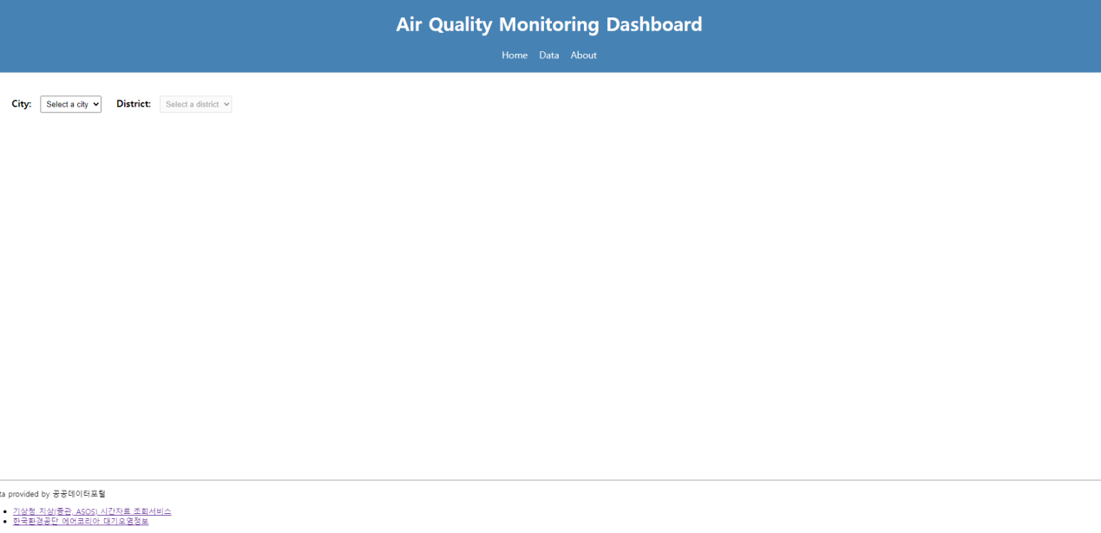
Work Completed So Far
Screen when no city is selected

Slide 7
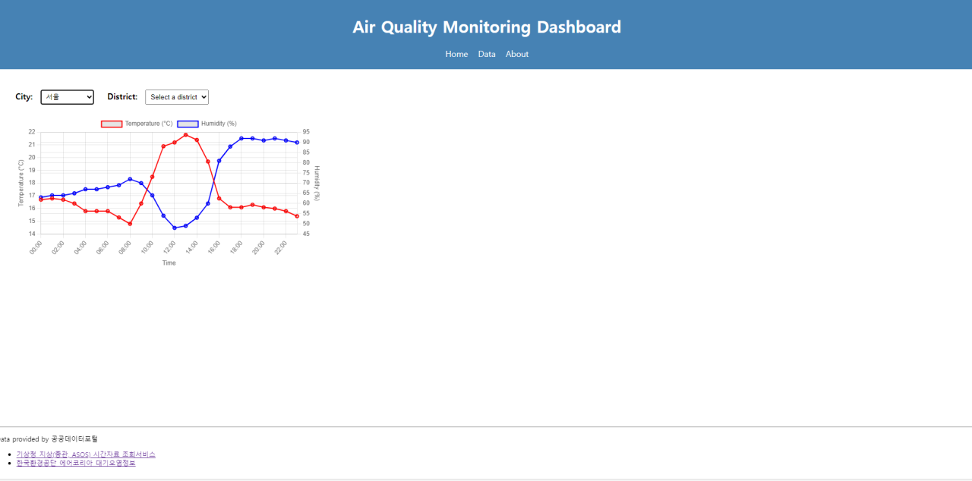
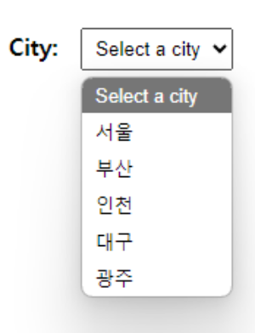
Work Completed So Far
After selecting a city, a line chart appears.

Slide 8
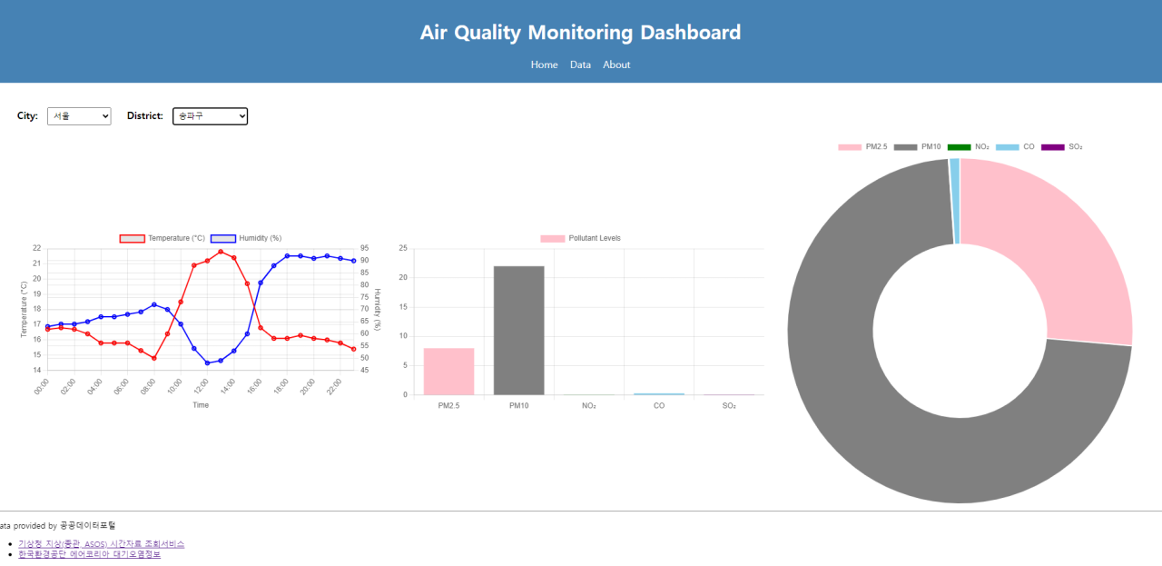
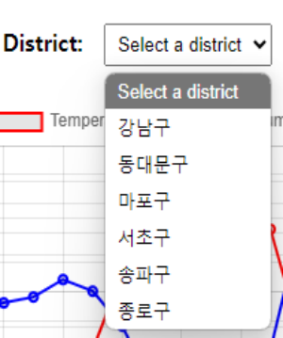
Work Completed So Far
After selecting a district, a bar chart and a donut chart appear

Slide 9
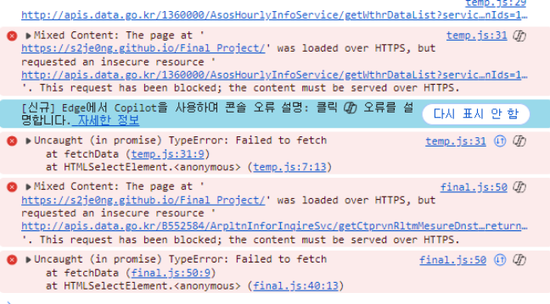

Work Completed So Far
Current Errors and Issues to Be Fixed
- No errors occur when opening the webpage on a local host.
- However, the following error occurs when accessing the deployed GitHub URL
I think that this is CORS error
Additionally, the temperature and humidity data are not real-time but fixed to a specific date.

Slide 10


Upcoming Plans
Resolving Current
Problems
Create Home, Data, and About web pages
Overall design modifications using CSS
1. A CORS (Cross-Origin Resource Sharing) error occurs due to a mismatch between the HTTP and HTTPS protocols.
=> Attempt to resolve using a proxy server
2. Modify the code to fetch real-time data
When Home is clicked: Display an initial screen showing the charts.
2. When Data is clicked: Display a screen explaining detailed items such as air quality data.
3. When About is clicked: Display a screen explaining the sources of the data and the purpose of this site.
The screen is too rough.
=> Use CSS for styling and layout, possibly utilizing a CSS framework.
=> Implement color coding to indicate air quality levels

Slide 11
THANK
YOU!
PARK Sejeong 202125203
Web application programming
Final Project

